Slide 1
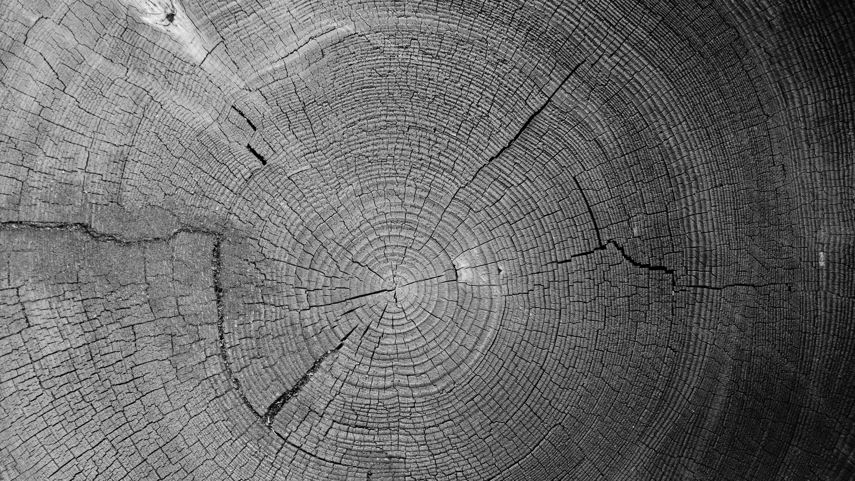
Issues With Decision Trees

Slide 2
Issues in Decision Tree Learning
Overfitting the data
Guarding against bad attribute choices
Handling continuous valued attributes
Handling missing attribute values

Slide 3
Overfitting of Data
A machine learning algorithm is said to be overfitted, when we train it with a lot of data.
When a model gets trained with so much of data, it starts learning from the noise and inaccurate data entries in our data set.
The model does not categorize the data correctly, because of too much of details and noise.
The causes of overfitting are the non-parametric and non-linear methods because these types of machine learning algorithms have more freedom in building the model based on the dataset and therefore they can really build unrealistic models.
A solution to avoid overfitting is using a linear algorithm if we have linear data or using the parameters like the maximal depth if we are using decision trees.

Slide 4
How can we prevent overfitting? Here are some common heuristics:
Don't try to fit all examples, stop before the training set is exhausted.
Fit all examples then prune the resultant tree.
How does one tell if a given tree is one that has overfit the data?
Extract a validation set not used for training from the training set and use this to check for overfitting. Usually the validation set consists of one-third of the training set, chosen randomly.
Then use statistical tests, eg. the chi-squared metric, to determine if changing the tree improves its performance over the validation set.
A variation of the above is to use MDL to check if modifying the tree increases its MDL with respect to the validation set.

Slide 5



Guarding against bad attribute choices
The information gain measure has a bias that favors attributes with many values over those with only a few.
For example, if you imagine an attribute Date with unique values for each training example, then Gain(S,Date) will yield H(S)
Obviously no other attribute can do better. This will result in a very broad tree of depth 1.
To guard against this, Quinlan uses GainRatio(S,A) instead of Gain(S,A).
Where
with P(S_{v}) estimated by relative frequency as before.

Slide 6



Handling continuous valued attributes
Note that continuous valued attributes can be partitioned into a discrete number of disjoint intervals. Then we can test for membership to these intervals.
If the Temperature attribute in the PlayTennis example took on continuous values in the range 40-90, note that we cannot just use the same approach as before.
Why? Because Temperature becomes a bad choice for classification (It alone may perfectly classify the training examples and therefore promise the highest information gain like in the earlier Date example) while remaining a poor predictor on the test set.
The solution to this problem is to classify based not on the actual temperature, but on dynamically determined intervals within which the temperature falls.
For instance we can introduce boolean attributes , , and T > C instead of real valued T.
a, b and c can be computed dynamically based on boundaries where T is likely or known to change.

Slide 7
Handling missing attribute values
What happens if some of the training examples contain one or more ``?'', meaning ``value not known'' instead of the actual attribute values?
Here are some common ad hoc solutions:
Substitute ``?'' by the most common value in that column.
Substitute ``?'' by the most common value among all training examples that have been sorted into the tree at that node.
Substitute ``?'' by the most common value among all training examples that have been sorted into the tree at that node with the same classification as the incomplete example

